Slide 1
UN’s Sustainable Development Goals in World University Rankings

Slide 2
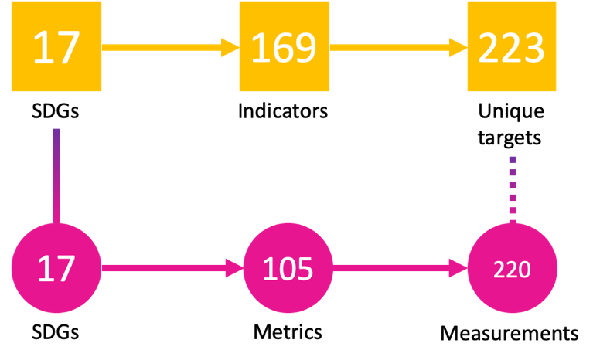
What do the SDGs mean?
Sustainability
Partnership
Equity, diversity, inclusion
Engagement
Sufficient resources
Long term thinking
31 000 Universities
In World University Rankings < 2 000

Slide 3
THE Rankings
TEACHING
RESEARCH
IMPACT & SUSTAINABILITY
Focus: teaching, research, international outlook, innovation
Focus: research output, research quality, research collaboration, reputation + more
Focus: research, teaching, stewardship and outreach against the UN’s 17 Sustainable Development Goals
Participation rules: publication threshold by discipline and an academic staff threshold by discipline
Participation rules: 1,000+ publications over 5 years, teach undergraduates across a range of subjects
Participation rules: all undergraduate or postgraduate higher education institutions

Slide 4
Which SDG is best for universities?

Slide 5
Which SDG is best for NURE?
2023
2022

Slide 6
How NURE can support the SDGs?
Research
Stewardship
Teaching
Outreach

Slide 7
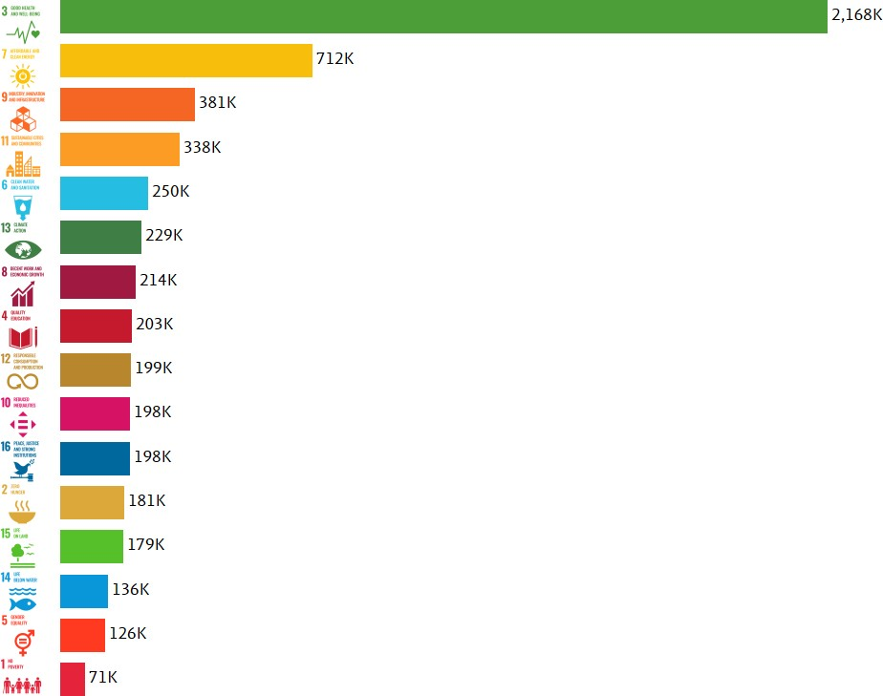
Research (Scopus, Elsevier)
SDG 3 Good Health and Well-being is the goal with the most publications produced between 2016 and 2020, comprising a 46% share of total SDG related publications.

Slide 8
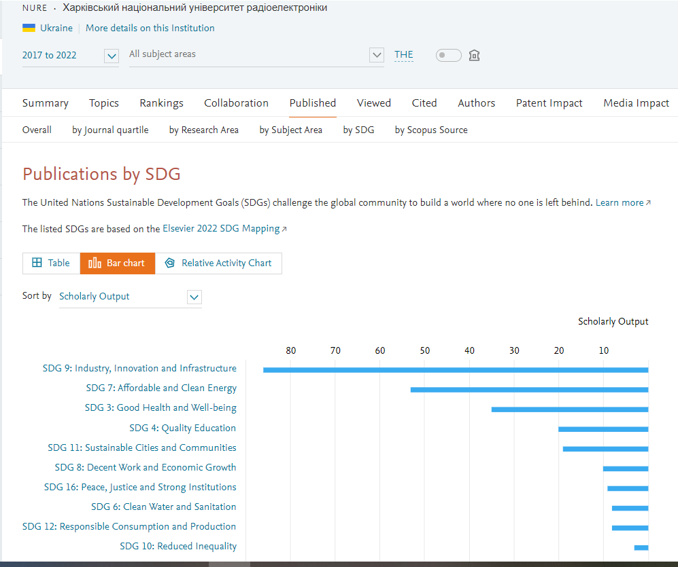
Publications by SDG SciVal data
Number of NURE publications (Scholary Output) on the United Nations Sustainable Development Goals (SDGs) in 2017-2022 which uses the THE Impact Rankings

Slide 9
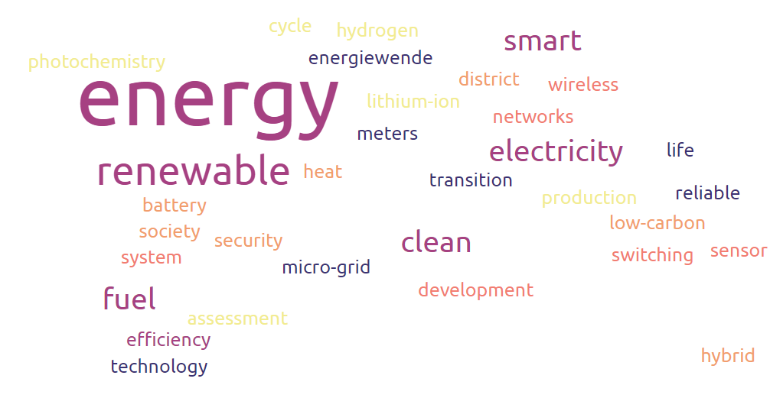
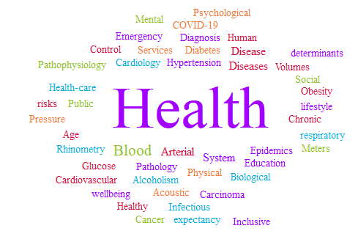
Keywords associated with SDG 3
Keywords associated with SDG 7

Slide 10
Creating an annual score
An annual score is created from SDG 17 and the three strongest SDGs for a university Universities could submit to as many SDGs as they wished
Bibliometrics will always represent the same proportion of overall score, regardless of SDGs chosen
17
+ A
+ B +
C
22
+
26
+
26
+
26
=100%

Slide 11
SDG 9: Industry, Innovation and Infrastructure

Slide 12
SDG 16: Peace, Justice and Strong Institution

Slide 13
What should we be doing?
Ensure our NURE is delivering on sustainability
Report progress on the SDGs
Involve young people and excluded groups – including refugees - in decision making
Work intersectionally across communities and SDGs
Realise the amazing asset of higher education for the good of society

Slide 14
Which is the highest priority SDGs for NURE?
12
10
8
6
4
2
0
SDG1
SDG2
SDG3
SDG4
SDG5
SDG6
SDG7
SDG8
SDG9
SDG10
SDG11
SDG12
SDG13
SDG14
SDG15
SDG16
SDG17

